Slide 1
AI Career Compass: Product Management Using Jira

Slide 2
Abstract
AI Career Compass is a product management project designed to help users identify suitable career paths based on their skills, interests, and career goals using an AI-driven recommendation approach.
The project follows the Agile Scrum methodology, where the product backlog, epics, user stories, story points, and sprints are planned and managed using Jira to ensure an organized development process.
The project demonstrates essential product management practices such as sprint planning, backlog prioritization, task tracking, and progress monitoring, enabling efficient collaboration and timely delivery of project features.
The successful implementation of Agile practices and Jira provides a structured workflow, improves project visibility, and enhances team productivity, making the project suitable for real-world software product development

Slide 3
problem statement
Many students and job seekers face difficulty in choosing the right career path due to a lack of personalized career guidance and limited understanding of their skills and interests.
Traditional career counseling methods are often time-consuming, expensive, and unable to provide real-time, data-driven recommendations tailored to individual users.
Managing the development of a career guidance platform without a structured product management approach can lead to poor requirement tracking, inefficient collaboration, and delays in project delivery.

Slide 4
Objectives
To design and manage the AI Career Compass project using Agile Scrum methodology and Jira for efficient project planning and execution.
To create and organize the product backlog, epics, user stories, and sprint plans for effective requirement management.
To monitor project progress by estimating story points, managing sprint workflows, and tracking task status through Jira boards.
To improve collaboration, productivity, and timely delivery of project features by following structured product management practices.

Slide 5
Existing System
Traditional career guidance mainly relies on manual counseling, online research, and generic aptitude tests, which often provide limited personalized recommendations.
Many organizations manage software projects using spreadsheets, emails, or unstructured documentation, making it difficult to track requirements, tasks, and project progress.
Without Agile tools such as Jira, project planning, sprint management, and collaboration become less efficient, leading to communication gaps and delayed delivery.
The existing approach lacks real-time task tracking, backlog management, sprint planning, and transparent progress monitoring, making it challenging to manage product development effectively.

Slide 6
Methodology: Agile Scrum
Agile Scrum Methodology
The project follows the Agile Scrum methodology, which focuses on iterative development, continuous feedback, and collaboration among team members. The work is divided into short development cycles called Sprints, where features are planned, developed, tested, and reviewed. User requirements are maintained in the Product Backlog, prioritized based on business value, and implemented incrementally. This approach enables flexibility, faster delivery, and continuous improvement throughout the product development lifecycle.
Scrum Workflow
Product Backlog
Sprint Planning
Sprint Backlog
Sprint (Development)
Daily Scrum
Sprint Review
Sprint Retrospective
Product Increment
Benefits of Agile Scrum
Faster and incremental product delivery
Better collaboration among team members
Easy adaptation to changing requirements
Continuous customer feedback
Improved product quality
Better risk management

Slide 7
Flowchart
Start │ ▼ User Registers / Logs In │ ▼ Complete Profile │ ▼ Take Skill Assessment Quiz │ ▼ System Analyzes Responses │ ▼ AI Generates Career Recommendations
│ ▼ View Recommended Careers
│ ▼ Explore Courses & Learning Roadmap
│ ▼ Save Preferred Career │ ▼ Track Progress on Dashboard │ ▼ End

Slide 8
Agile Scrum Project Management Process
1. Product Backlog
Identified and documented all product requirements.
Prioritized features based on business value and user needs.
Organized requirements into Epics, User Stories, and Tasks.
Continuously updated the backlog based on stakeholder feedback.
2. Sprint Planning
Selected high-priority backlog items for the sprint.
Estimated effort using Story Points.
Assigned tasks and defined sprint goals.
Set acceptance criteria and sprint timelines.

Slide 9
Agile Scrum Project Management Process
3. Scrum Board
Tracked task progress through different workflow stages.
Managed work using To Do, In Progress, Testing, and Done.
Monitored sprint progress and team collaboration.
Ensured transparency and timely task completion.
4. Sprint Review & Retrospective
Demonstrated completed features at the end of each sprint.
Gathered stakeholder feedback for product improvements.
Identified challenges and areas for process improvement.
Updated the backlog and planned the next sprint.

Slide 10
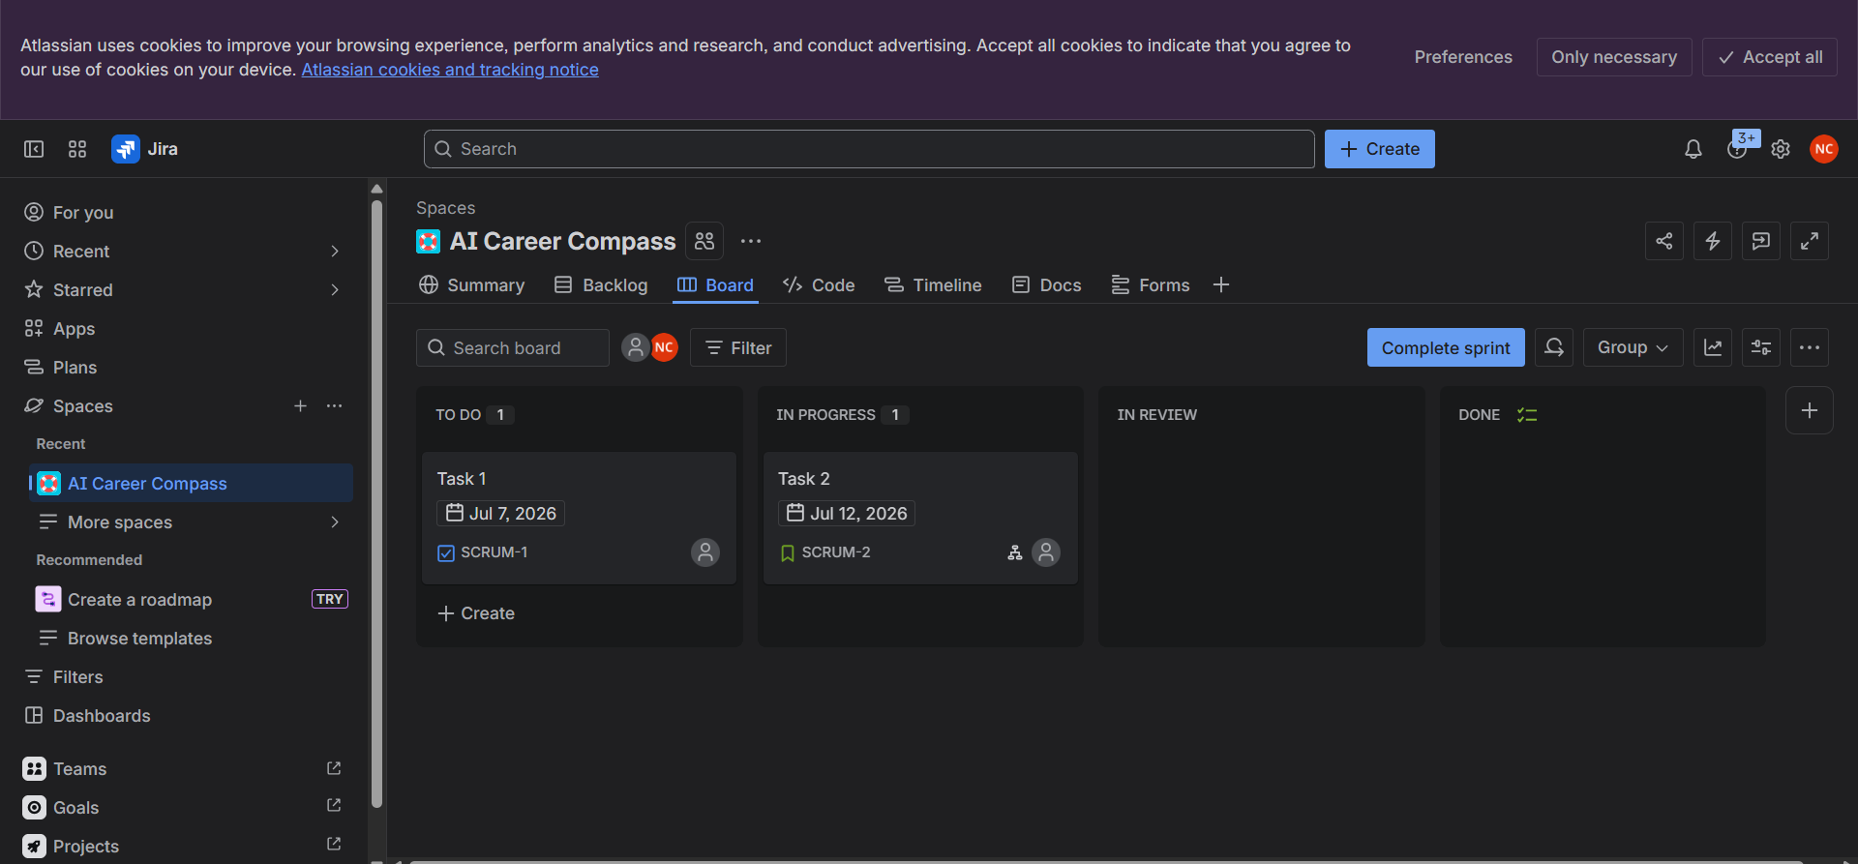
OUTPUT(SCREEN SHOTS)
1. Project Creation

Slide 11
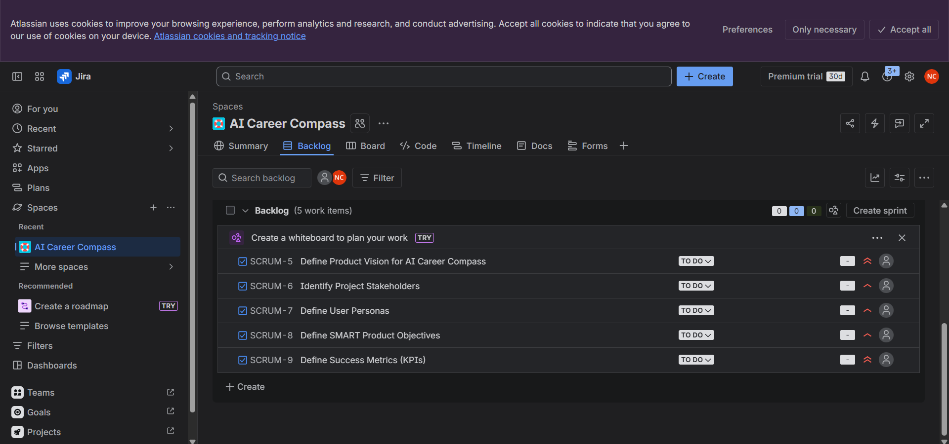
OUTPUT(SCREEN SHOTS)
2.1 Product Backlog

Slide 12
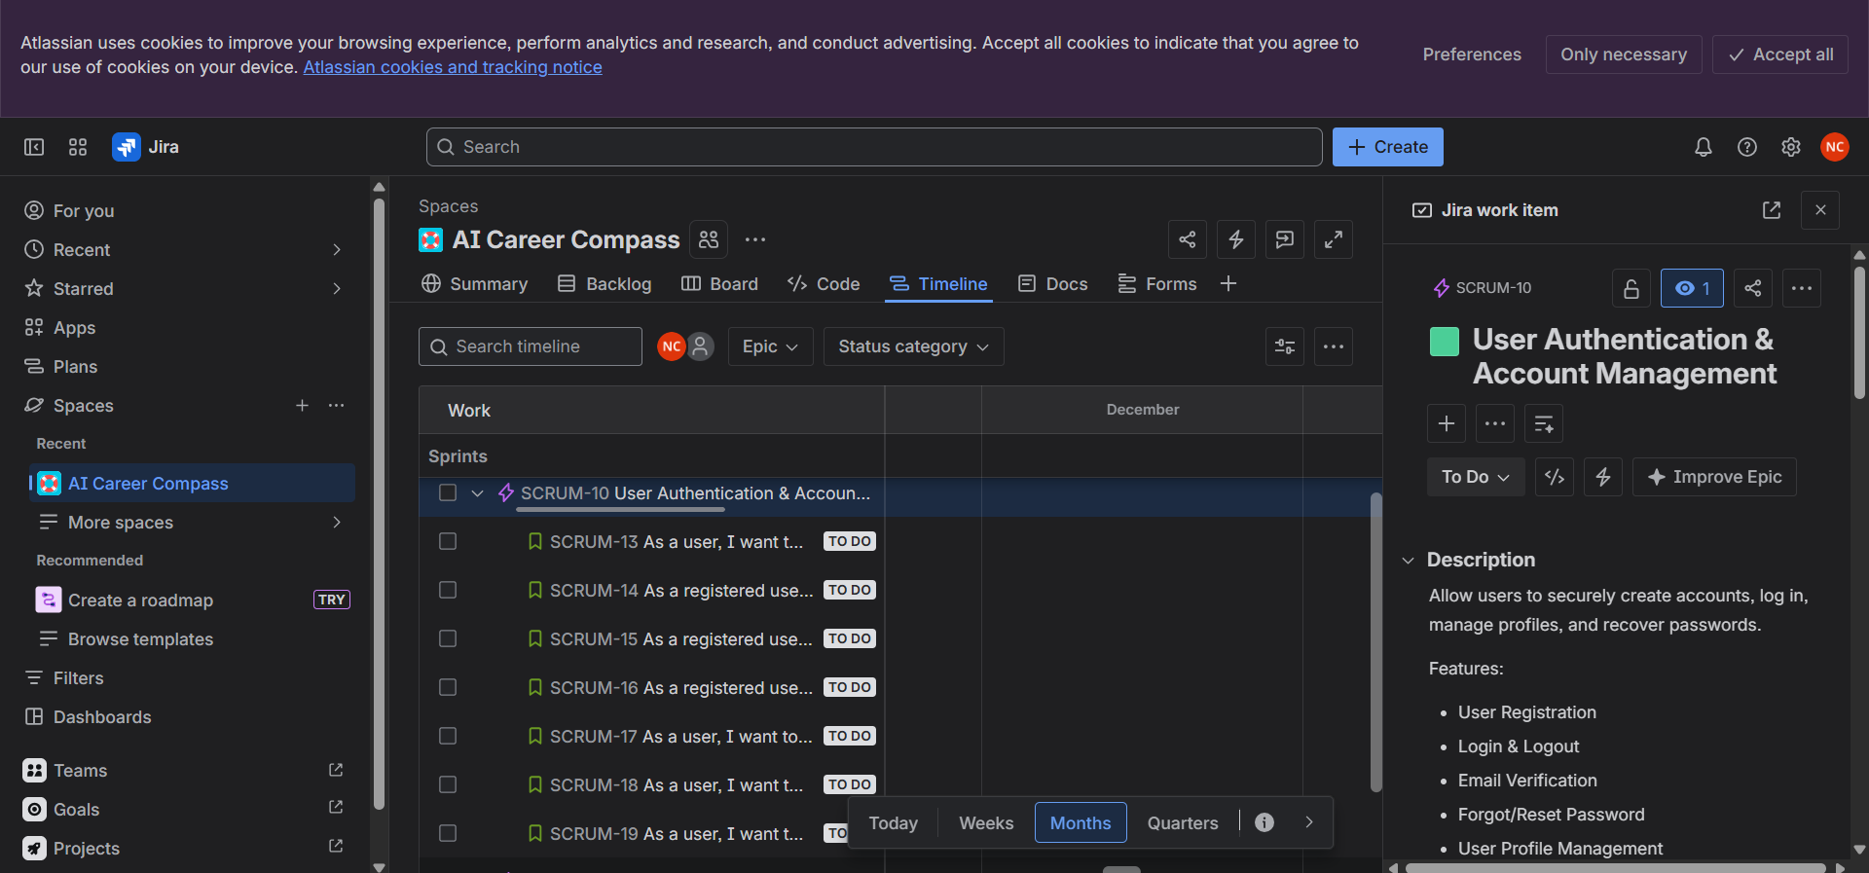
OUTPUT(SCREEN SHOTS)
2.2 Product Backlog

Slide 13
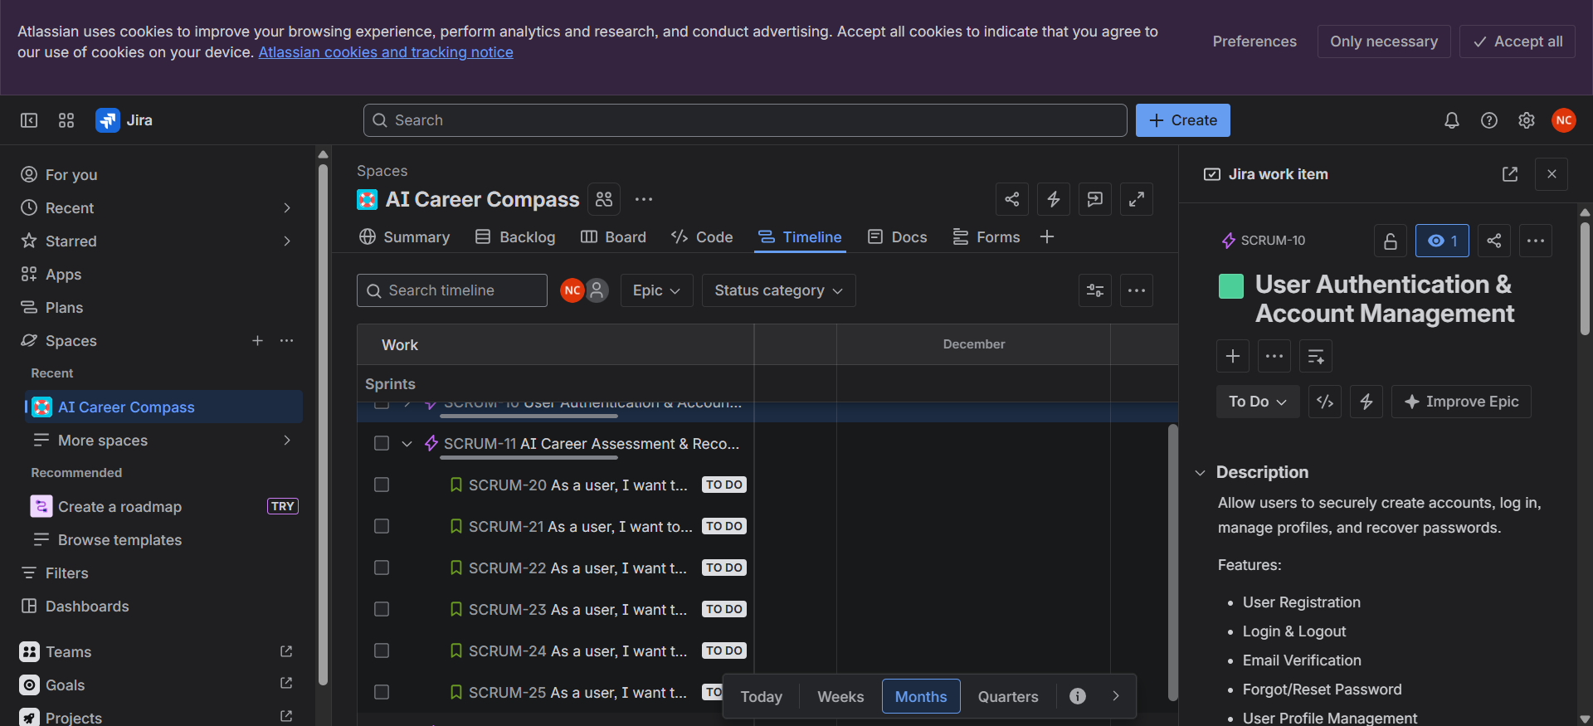
OUTPUT(SCREEN SHOTS)
2.3 Product Backlog

Slide 14
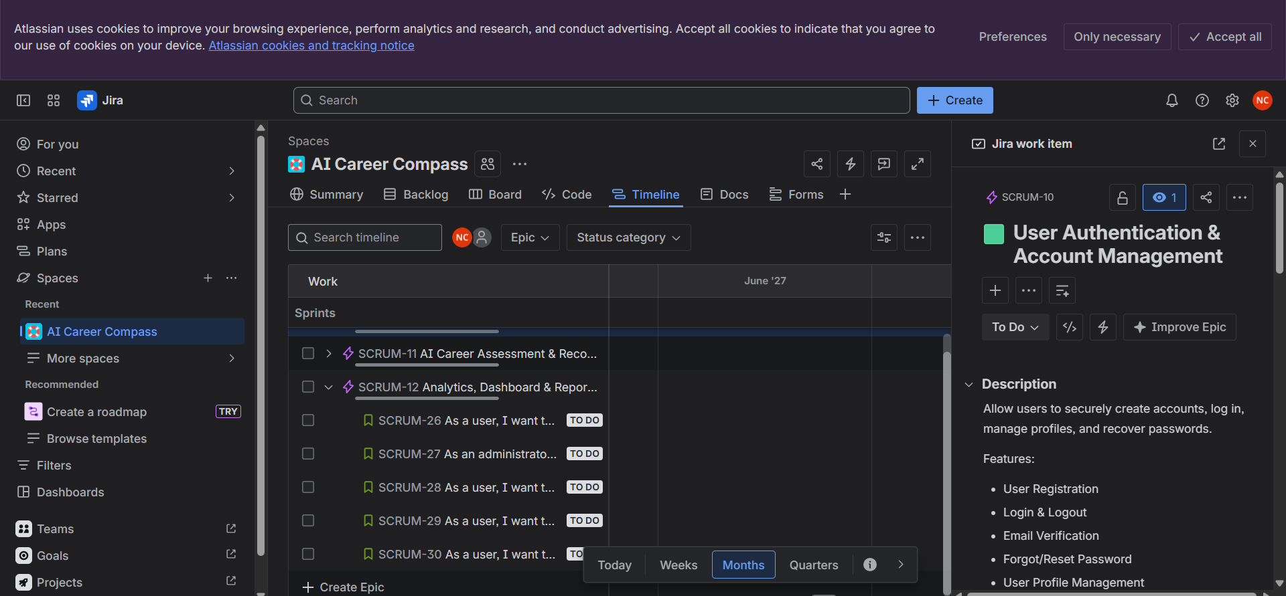
OUTPUT(SCREEN SHOTS)
2.4 Product Backlog

Slide 15
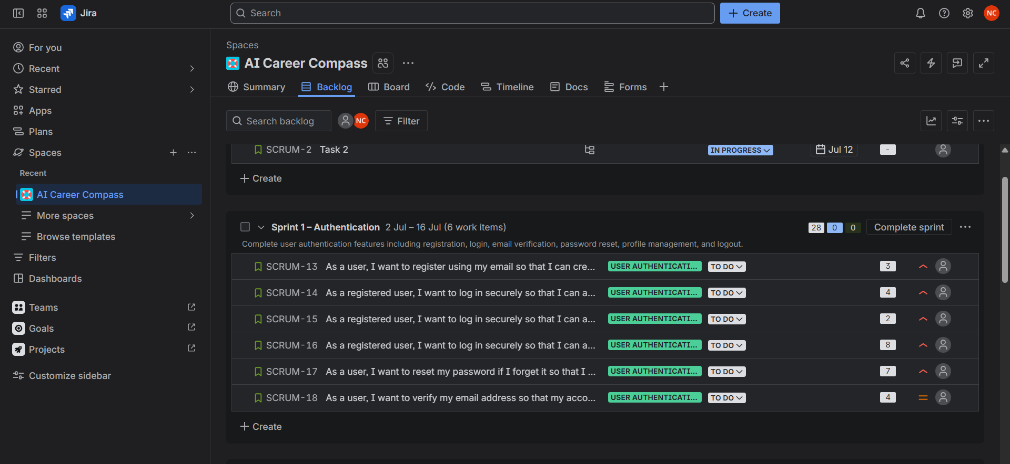
OUTPUT(SCREEN SHOTS)
3. Sprint Creation

Slide 16
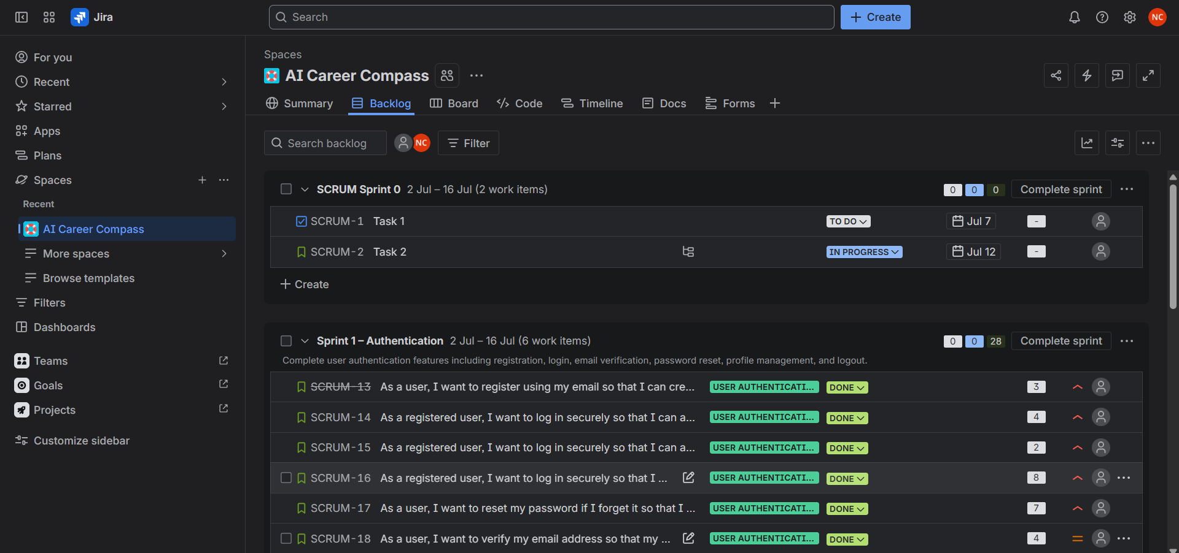
OUTPUT(SCREEN SHOTS)
4. Task Progress

Slide 17
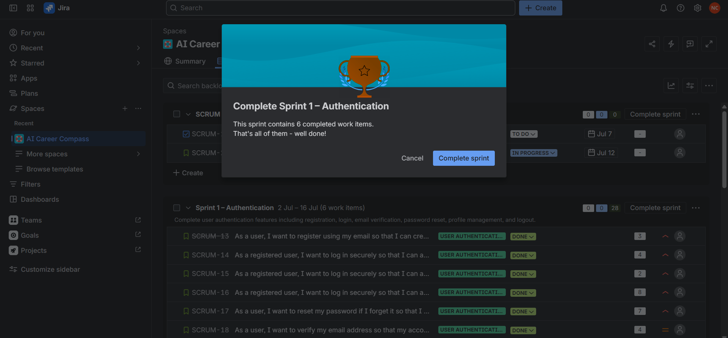
OUTPUT(SCREEN SHOTS)
5. Sprint Completed

Slide 18
Results
Successful Product Planning
The product requirements were successfully analyzed, prioritized, and organized into a structured Product Backlog, ensuring that the most valuable features were identified and planned for development.
Effective Agile Scrum Execution
The project was executed using the Agile Scrum methodology with sprint planning, backlog management, and Scrum Board tracking, enabling systematic development and continuous progress monitoring.
Improved Project Management and Collaboration
Using Jira helped streamline task management, prioritize user stories, track sprint progress, and improve collaboration and transparency throughout the product development lifecycle.
MVP Delivery and Future Scalability
A well-defined Minimum Viable Product (MVP) was successfully planned with core features, and a scalable product roadmap was prepared to support future enhancements and continuous product improvement.

Slide 19
Conclusion
The project successfully demonstrated the application of Agile Scrum methodology in planning and managing a product from concept to execution using Jira.
By implementing product management practices such as backlog prioritization, sprint planning, and user story creation, the project ensured an organized and efficient development process
.
The project highlighted the importance of continuous feedback, collaboration, and iterative improvements in delivering a user-focused and high-value product.
Overall, the project enhanced practical knowledge of Product Management, Agile methodologies, and Jira, providing a strong foundation for managing real-world software products and future product development initiatives.

Slide 20
Future Scope
1. AI-Powered Personalized Recommendations
Enhance the recommendation engine using advanced AI and machine learning to provide more accurate and personalized career guidance based on user skills, interests, and learning patterns.
2. Integration with Job Portals
Connect the platform with popular job portals to recommend relevant job opportunities, internships, and placement drives based on the user's profile.
3. Skill Assessment and Certification
Introduce advanced skill assessment tests and integrate certification platforms to help users validate and improve their technical and professional skills.
4. Real-Time Career Analytics
Develop an analytics dashboard that tracks user progress, career trends, in-demand skills, and personalized performance insights to support informed career decisions.
5. Mobile Application and Cloud Deployment
Expand the platform into a mobile application with cloud-based deployment, enabling users to access career guidance, recommendations, and progress tracking anytime and anywhere.

Slide 21
References
Atlassian. Jira Software Documentation. Available at: https://www.atlassian.com/software/jira
Atlassian. Agile Coach – Scrum Guide and Agile Practices. Available at: https://www.atlassian.com/agile
The Scrum Guide. Ken Schwaber & Jeff Sutherland, 2020.
Inspired: How to Create Tech Products Customers Love. Marty Cagan, 2nd Edition, 2018.
Lean Product and Lean Analytics. Ben Yoskovitz & Alistair Croll.
Project Management Institute (PMI). Agile Practice Guide.
Scrum Alliance. Scrum Framework and Best Practices.
International Institute of Business Analysis (IIBA). Business Analysis Body of Knowledge (BABOK® Guide).
Google. Google UX Design & Product Design Learning Resources.
Coursera. Product Management, Agile, and Scrum Learning Resources..

Slide 22
THANK YOU
By
Nishanth CS

